Slide 1
Presentation and visualization
2020-Sept. What is information visualization?
Mireia Ribera ribera@ub.edu

Slide 2
What is information visualization?

Slide 3
Marti Hearst
“To show information in a spatial or graphical representation, in order to facilitate comparison, pattern recognition, change detection, and other cognitive aptitudes of our visual system”
Notes:
Communicate

Slide 4
Robert Spencer
“Get and Ahaaa! answer from the user, indicating she obtained a new view of the data which has helped to better understand it”
Notes:
Knowledge discovery

Slide 5
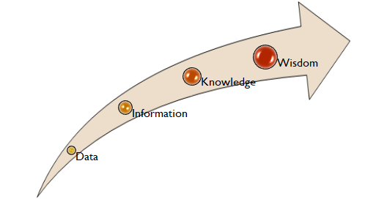
Juan Carlos Dürsteler
“The knowledge interiorization process through the perception of information”
Notes:
Information digestion

Slide 6
In brief
Communicate
Clearly
Efficiently
Facilitate discovery
To identify relations
To discover patterns
Help digest the data

Slide 7
A very simple example: (2000-2010)
public expenditure percentage on education
Which country is spending more on education?
Which country is increasing its inversion?
Which one is decreasing it?

Slide 8
Country | 2000 | 2001 | 2002 | 2003 | 2004 | 2005 | 2006 | 2007 | 2008 | 2009 | 2010
AUSTRALIA | 13,6 | 13,6 | 13,6 | 13,6 | 13,6 | 13,6 | 13,2 | 13,0 | 12,6 | 13,4 | 14,3
AUSTRIA | 11,1 | 10,9 | 10,9 | 10,5 | 10,0 | 10,3 | 10,5 | 10,5 | 10,6 | 10,7 | 10,9
BRAZIL | 11,5 | 10,6 | 9,6 | 10,0 | 10,4 | 11,3 | 12,4 | 13,2 | 14,1 | 14,7 | 14,6
CANADA | 12,7 | 12,2 | 12,2 | 12,2 | 12,2 | 12,2 | 12,3 | 12,4 | 12,1 | 12,5 | 12,4
COLOMBIA | 13,3 | 13,5 | 15,3 | 15,5 | 15,4 | 15,5 | 13,8 | 14,5 | 14,7 | 16,1 | 16,4
DENMARK | 15,3 | 15,5 | 15,4 | 15,1 | 15,5 | 15,8 | 15,5 | 15,4 | 14,8 | 14,9 | 15,1
FINLAND | 12,2 | 12,6 | 12,7 | 12,8 | 12,8 | 12,2 | 12,3 | 12,2 | 12,1 | 11,8 | 12,0
ITALY | 9,4 | 9,8 | 9,5 | 9,6 | 9,4 | 9,0 | 9,5 | 8,8 | 9,2 | 8,9 | 8,7
MEXICO | 19,8 | 20,8 | 21,0 | 23,6 | 22,8 | 22,6 | 20,7 | 20,3 | 18,7 | 19,2 | 19,3
SPAIN | 10,7 | 10,7 | 10,7 | 10,9 | 10,7 | 10,8 | 10,9 | 10,9 | 10,9 | 10,6 | 10,6
SWEDEN | 13,0 | 12,9 | 13,2 | 13,0 | 13,1 | 12,8 | 12,8 | 12,9 | 13,1 | 13,2 | 13,3
UNITED KINGDOM | 12,1 | 12,3 | 13,6 | 13,6 | 13,0 | 13,2 | 13,2 | 13,0 | 13,0 | 12,6 | 13,0
UNITED STATES | – | – | 16,4 | 16,4 | 15,5 | 15,0 | 15,0 | 14,4 | 14,0 | 12,8 | 13,0

Slide 9
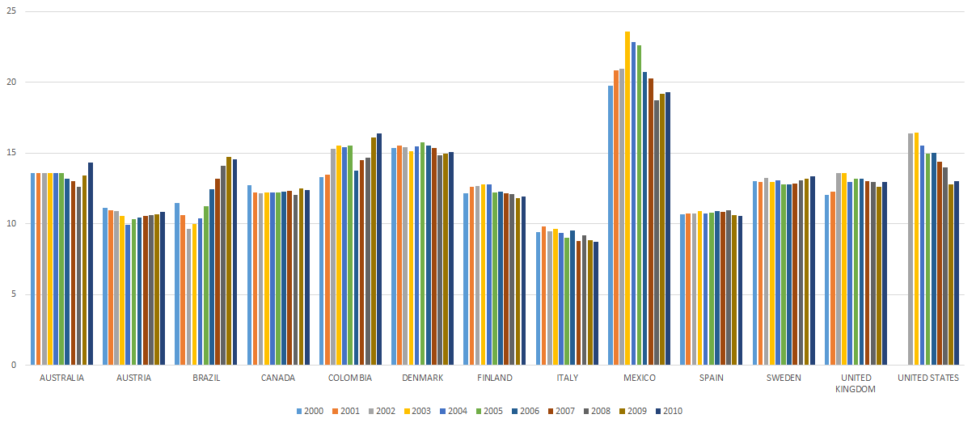
A very simple example

Slide 10
Some nicer examples

Slide 11
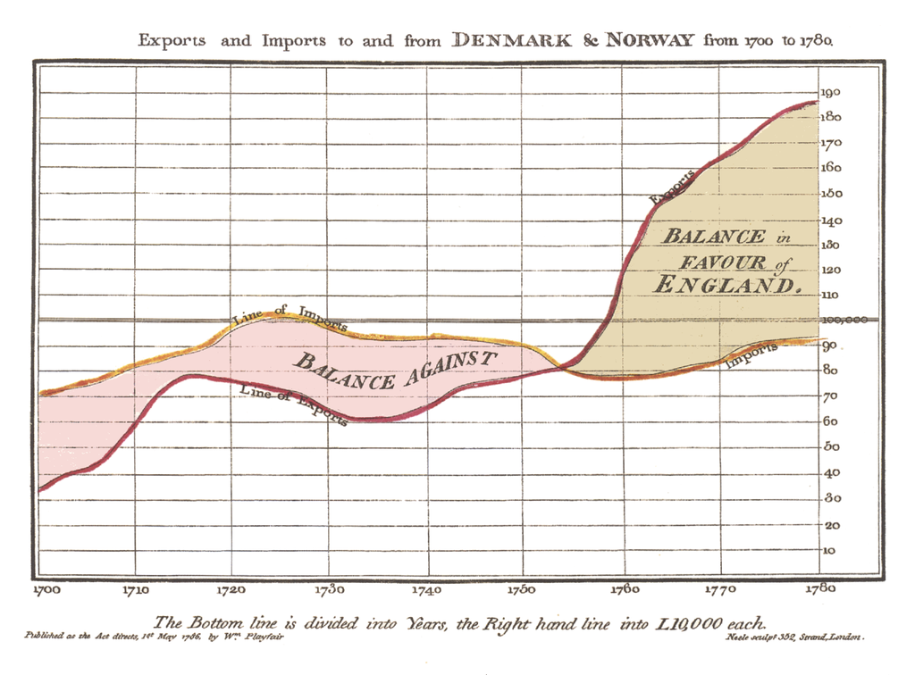
Communicate example I: William Playfair (1786)
Line, bar and pie charts were all invented by William Playfair.

Slide 12
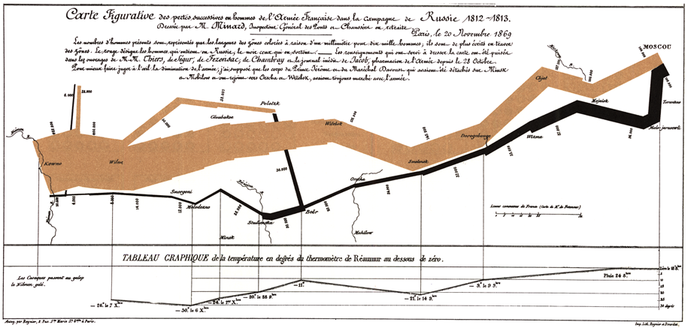
Communicate example II: Joseph Minard
Notes:
Number of Napoleon troops
Distance traveled
Temperature
Latitude and longitude
Direction of travel
Location relative to specific dates

Slide 13
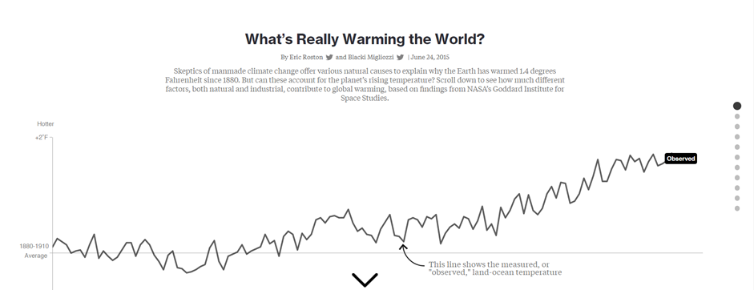
Communicate example III: New York Times

Slide 14
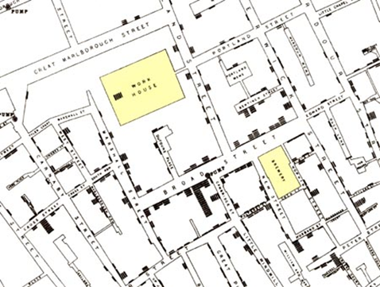
Knowledge discovery I
What was the cause of the cholera epidemics in London in 1854?
John Snow discovered it through visualization
Source: Visual Explanations Tufte Graphics Press, 1997

Slide 15
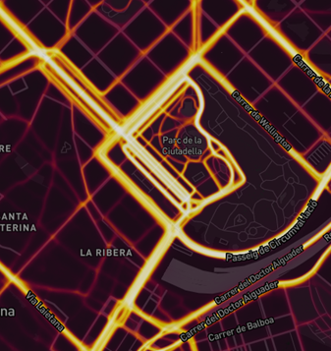
Knowledge discovery II (incidental)
Strava heat map made visible military bases

Slide 16
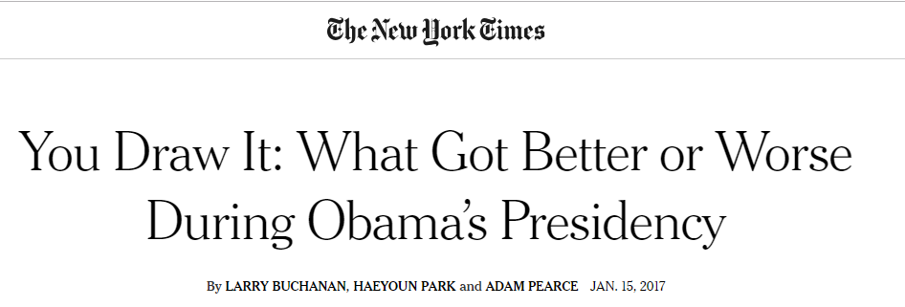
Knowledge discovery III

Slide 17
To communicate clearly you must avoid some misleading practices

Slide 18
Misleading practices

Slide 19
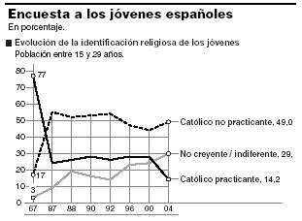
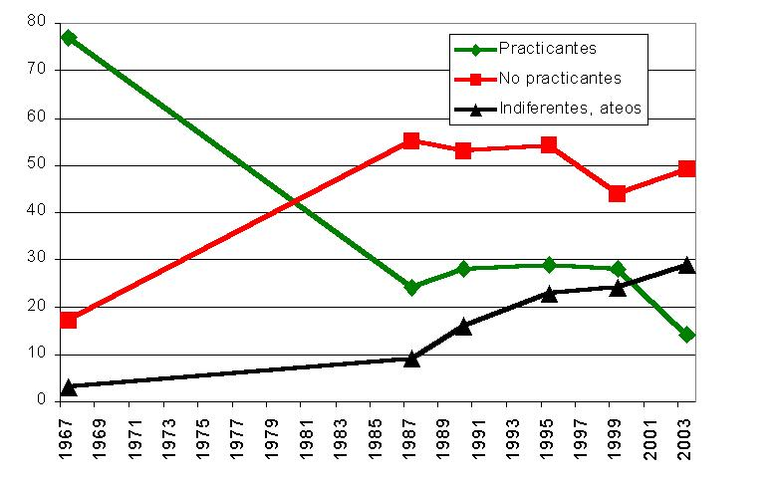
Scales are not regular
What is wrong?
Source: malaprensa [http://www.malaprensa.com]

Slide 20
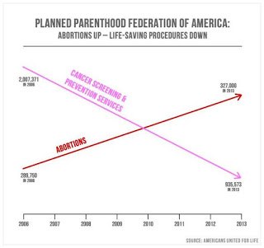
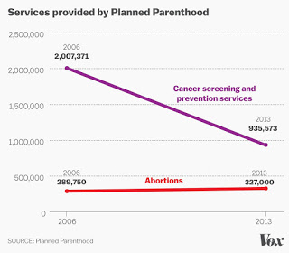
Dual axes
What is wrong?
Source: Cairo Truthful charts
Notes:
Left chart uses different axis for every line-chart. Right chart unifies the axis.

Slide 21
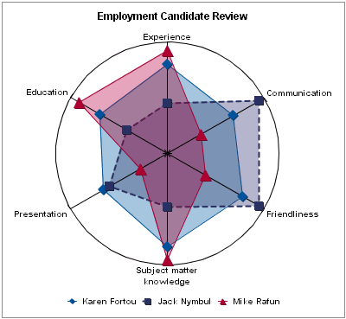
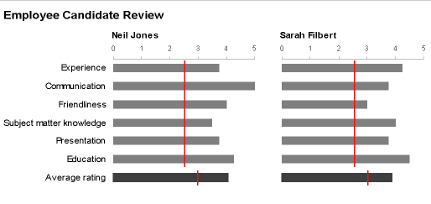
Use the appropriate chart
What is wrong?
Source: Few Perceptual edge
Notes:
Not easy to see on the first one

Slide 22
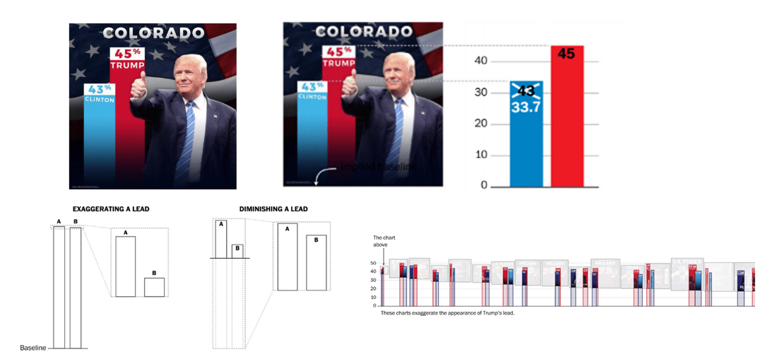
Bar charts length. Always start at 0

Slide 23
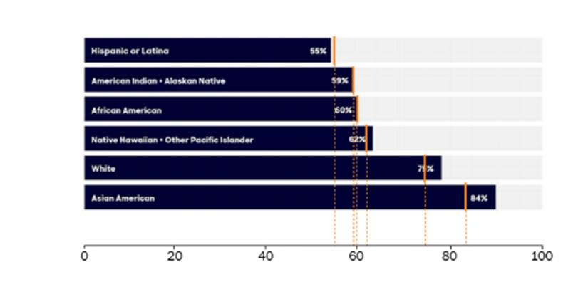
Use scales wisely
Notes:
The bar chart lenght does not correspon to a uniform scale

Slide 24
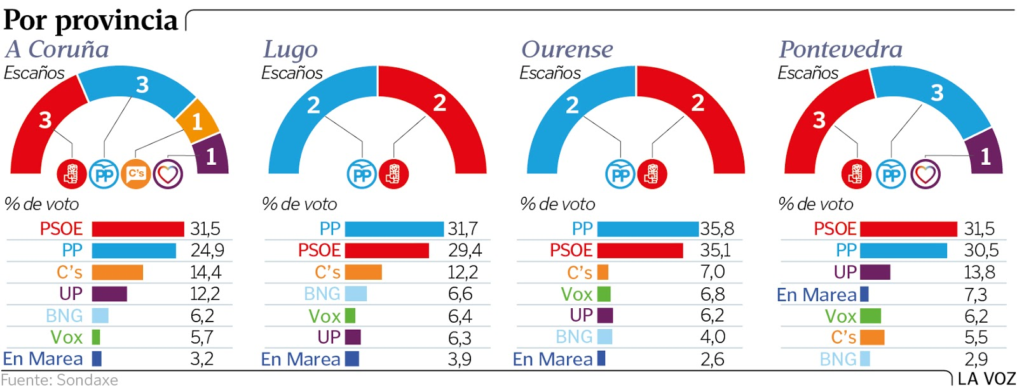
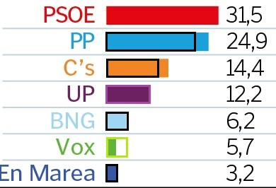
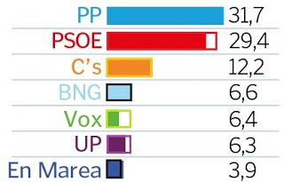
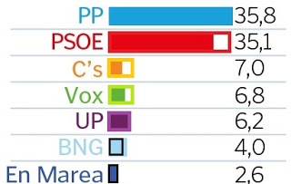
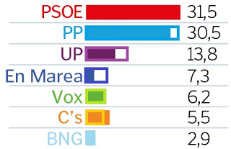
Use scales wisely II
Notes:
The bar chart lenght does not correspon to a uniform scale

Slide 25
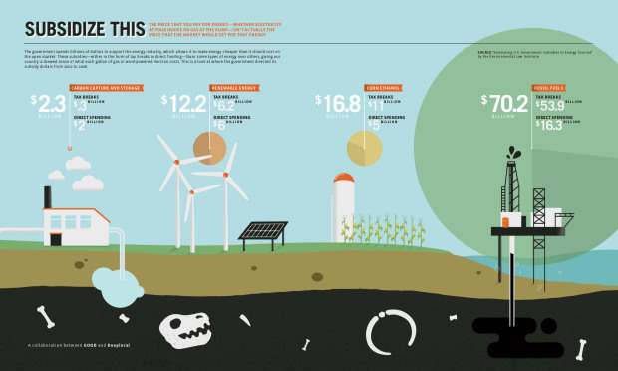
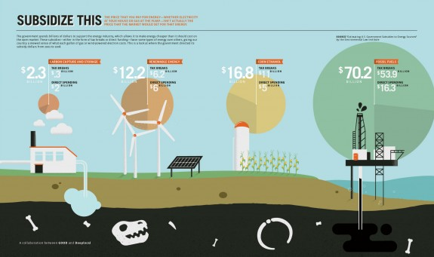
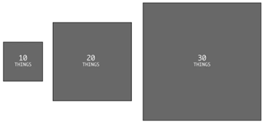
Area vs diameter, be careful!
Bad
Right
Notes:
If area is the visual encoding, then one has to size by area. When someone linearly sizes an area-based encoding, like a square or a circle, they might be sniffing for dramatics. Right chart increases the radio, while left chart increases the area.

Slide 26
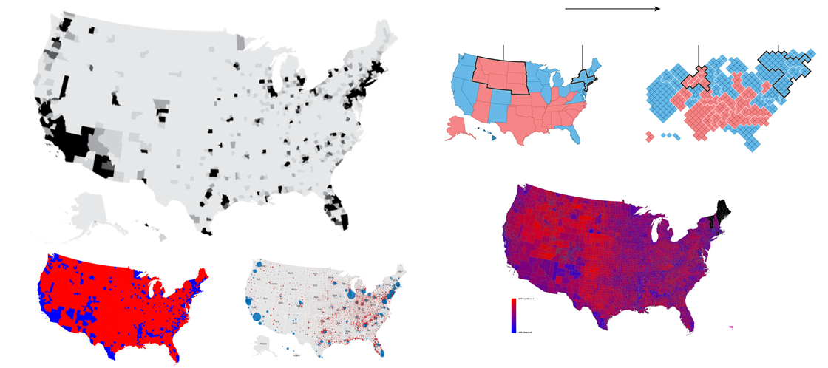
Don’t oversimplify with aggregation
Notes:
A great diversity could be hidden with aggregation

Slide 27
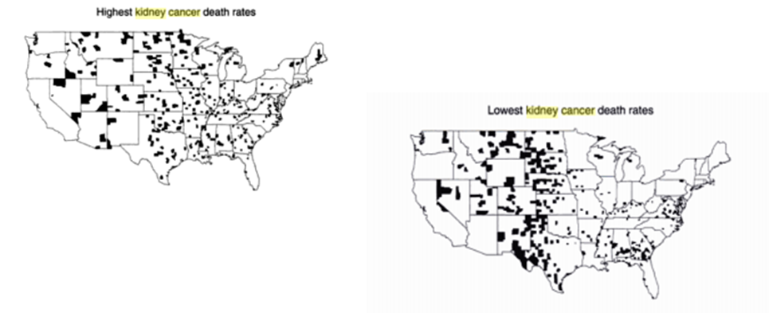
Small size effect
Notes:
When the sample is very small data does not follow a normal pattern. In these examples 1 death could mean 10% of deaths. ESTANDARITZAR

Slide 28
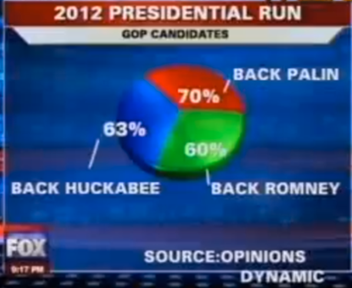
Basic arithmetics. Follow conventions
Notes:
If you add the percentages they sum up more than 100%!

Slide 29
To communicate clearly you must follow some best practices

Slide 30
Best practices

Slide 31
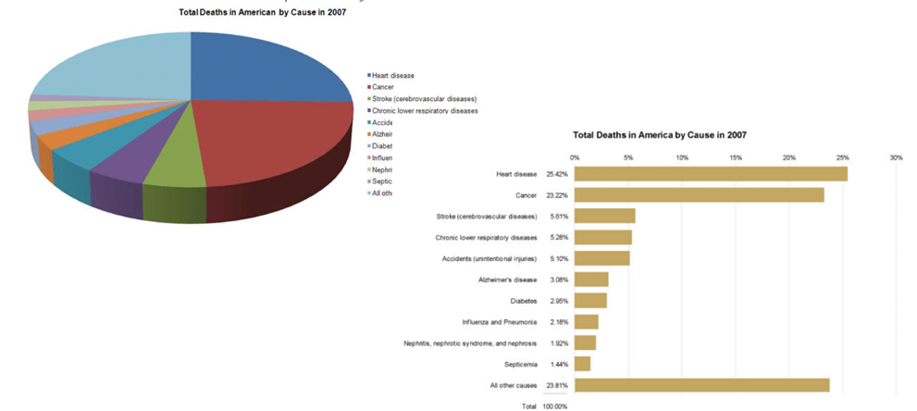
Use the appropriate chart
Notes:
Clearly indicates the nature of the relationship?
Represents the quantities accurately?
Makes it easy to compare the quantities?
Makes it easy to see the ranked order of values?
Makes obvious how people should use the information? Partially
From Data Visualization for human perception. Stephen Few

Slide 32
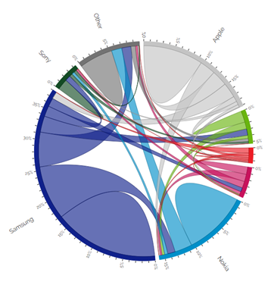
Offer clear legends: title, key to encodings, axes
You may even offer a tutorial, if the type of chart is not usual.

Slide 33
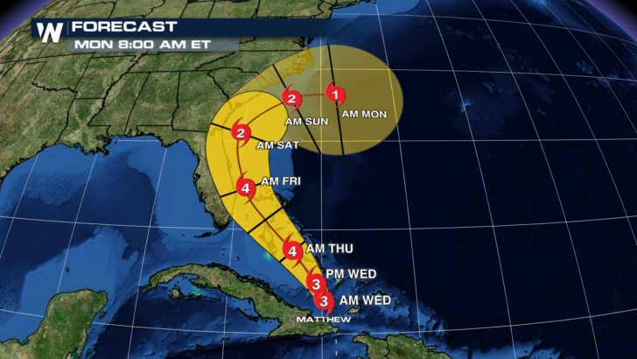
Tell uncertainty if it is relevant
How do you interpret this graph?
Which areas will be affected by the hurricane?

Slide 34
Disclose the origin of your data
•Readers should be able to go to the facts behind your chart and check them
•Tell your sources
•Link to them if possible

Slide 35
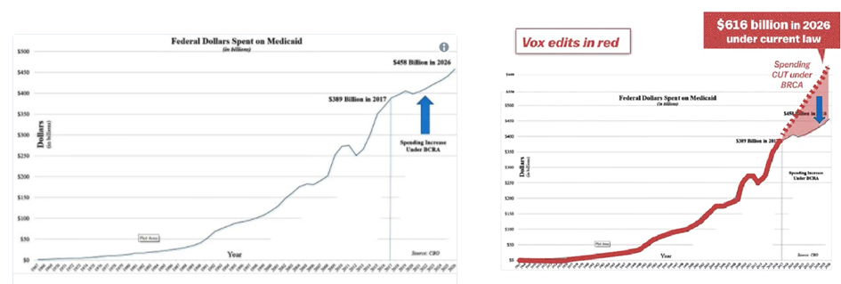
Give context to your data I
Notes:
Is the graphic showing an appropriate amount of data? Visualization should never simplify, it should always clarify

Slide 36
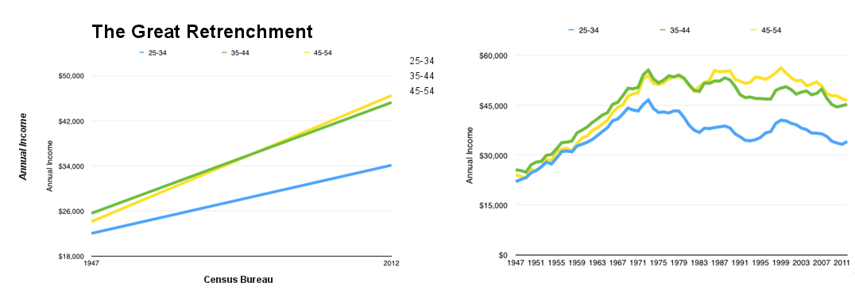
Give context to your data II
Bad
Good
Notes:
On the right showing all the years shows a more realistic pattern

Slide 37
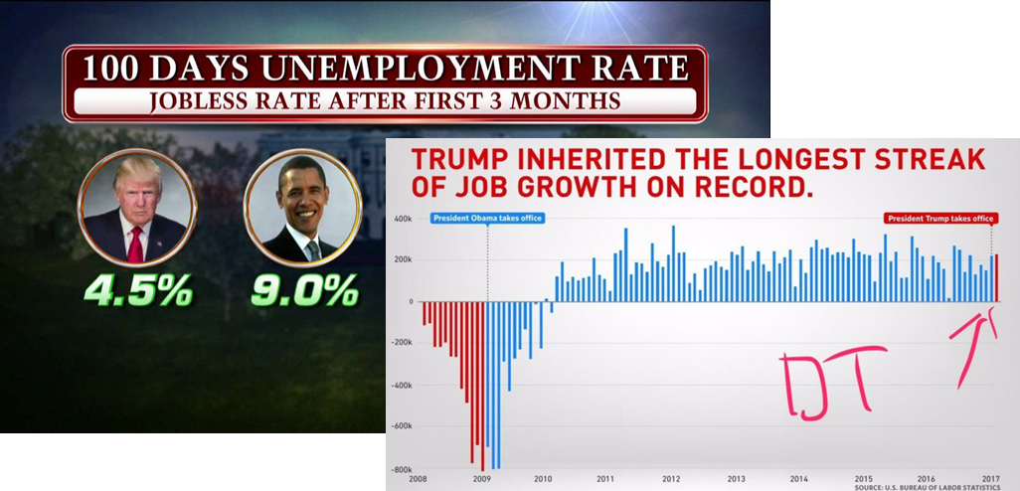
Give context to your data III
Notes:
The news refer only to the last data, while a complete view gives a very different perspective

Slide 38
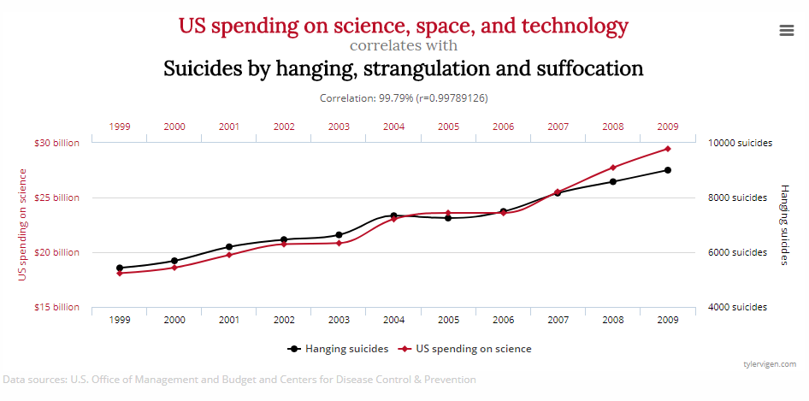
Don’t give the bad context

Slide 39
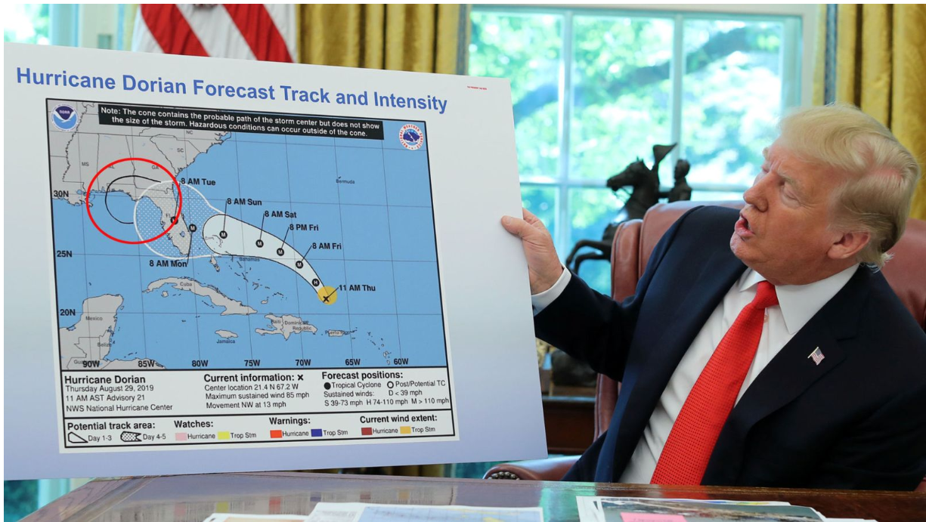
Ethics
Become aware from your own biases
Don’t twist facts to fit your agenda
Don’t share before checking

